Slide 1
Applied Machine learning
Regent College London
SWE6302

Slide 2
Applied Machine learning
SWE6302

Slide 3

Applied Machine learning
Deployment of Machine Learning Models and Introduction to Deep Learning

Slide 4
Module 1 – Deployment of Machine Learning Models and Introduction to Deep Learning

Slide 5
Learning objectives
Understand the ML Components
Understand the ML model flow
Understand the ML basic paradigm
Understand the ML modelling
Understand the core concepts of DL

Slide 6
Recap - AI, ML, Dl
Artifical
Artificial Intelligence is the capability of a machine to imitate intelligent human behaviour.
AI is achieved by mimicking a human brain, by understanding how it thinks, how it learns, decides, and work while trying to solve a problem.
Artificial Intelligence
Machine Learning
is a subset of
Artificial Intelligence
Machine learning focuses on developing algorithms that allow computers to learn from data and make predictions or decisions without being explicitly programmed.
Machine Learning
Deep Learning
Deep Learning
is a subset of
Machine Learning
Deep Learning uses neural networks to simulate human like decision making

Slide 7
Simplified Diagrammatic Implementation of ML
Training Data
Machine Learning Algorithm
Training
Prediction
“Live” Data / Test Data
Trained Model
Prediction

Slide 8
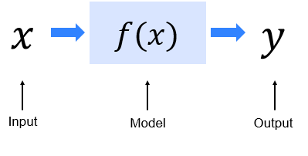
ML in Mathematical Representation

Slide 9
Machine Learning components
DATA – Without data, ML does not exist. Without quality, reliable and DIVERSE data, your ML system is rubbish (“Garbage in – Garbage out”)
A feature (predictor, variable) is an individual measurable property or characteristic of a phenomenon being observed – House price, price product, X-Rays, . . .
Algorithms: Linear regression, Support Vector Machines(SVM), K-Means, Neural Networks, …

Slide 10
Roadmap to solve complex problems
…with a Machine Learning Framework Remember:
ML is about predict results based on incoming data

Slide 11
What is ML?
It is a class of methods for automatically creating models from data → algorithms turn a data set into a model.
It is a technique where machines apply statistical learning techniques to automatically identify patterns in data.
A system that learns from experience. Whereas a rule-based system will perform a task the same way every time, the performance of a machine learning system can be improved through training, by exposing the algorithm to more data.

Slide 12
How things are learned
Generally, with machine learning, the inputs and outputs are used by the computer to generate a program that can be used with future collected data to compute the outputs.
There are two categories of knowledge in this realm, Declarative and Imperative Knowledge
  – Declarative Knowledge is based on the principal of memorization (accumulating individual facts); it is limited by the time and memory available
  – Imperative Knowledge is based on principal of generalisation (deducing new facts from old facts); limited by accuracy of deduction process since it is essentially a predictive activity and assumes past trends will allow prediction of the future

Slide 13
Use of generalization
Humans use generalisation to learn
When computer scientists speak about machine learning, most often they mean the discipline of writing programs that can automatically learn to make useful inferences from implicit patterns in data
E.g.- linear regression
But..
A student of political science might observe the behaviour of a large number of politicians and generalise from those observations that all the politicians lie on the campaign trail

Slide 14
Basic paradigm of ml
Observe a set of examples: Training Data
- This set represents an incomplete information about a phenomenon
Use inference to create a model of a process able to “generate” the training data
Use the model to make predications about previously unseen data
Variations of paradigm:
- Supervised: find a rule that predicts a label/feature for previously unseen data, using a set of label/feature pairs
- Unsupervised: group feature vectors (without labels) into natural clusters

Slide 15
Is the model learning In the correct way
Every machine learning approach has at least the 3 following components:
- A model
- An objective function for assessing the quality of the model
- An optimization method for enhancing the model (minimizing or maximizing the objective function)
Also, we need to have a metric (quantifiable measure) to compare the models!

Slide 16
Online resources
https://www.youtube.com/watch?v=olFxW7kdtP8
https://www.youtube.com/watch?v=iUUSamG4P80
https://www.youtube.com/watch?v=rADYARpj-V8
https://www.youtube.com/watch?v=IzcX9bTJLj8

Slide 17
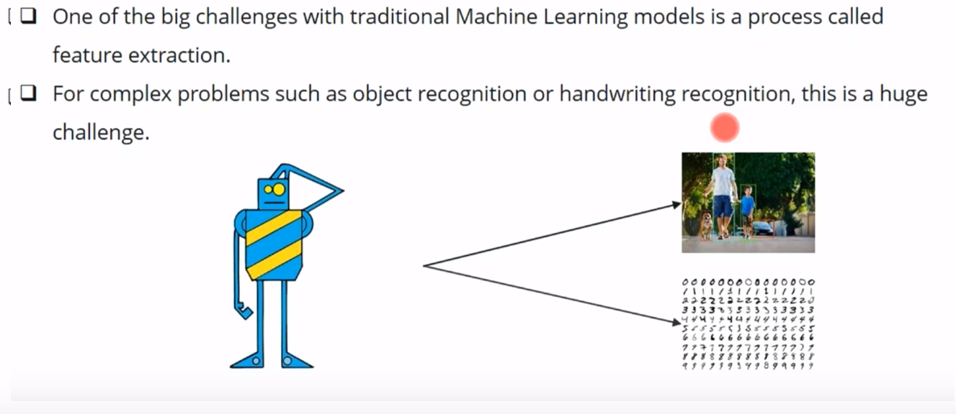
Limitations of ML

Slide 18
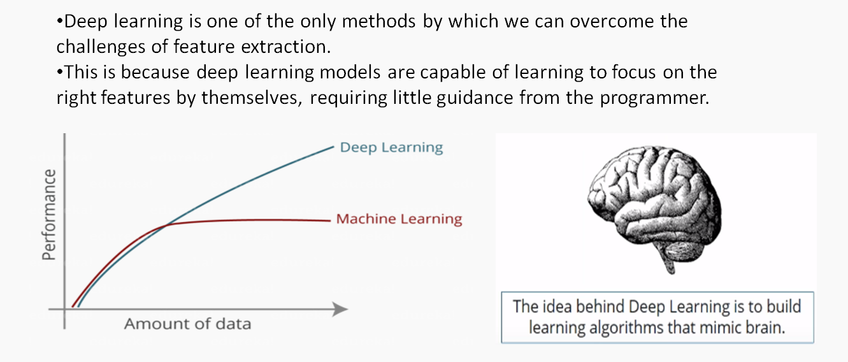
Deep Learning (DL) to the rescue

Slide 19
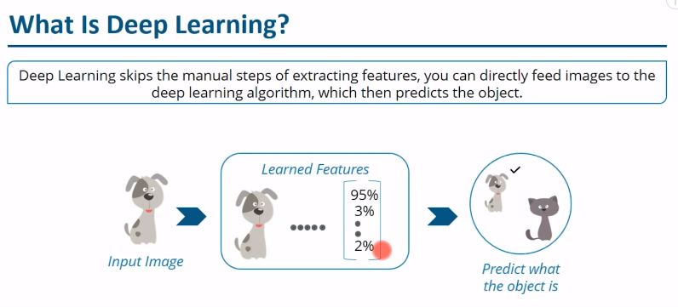
What is Deep Learning (An example)

Slide 20
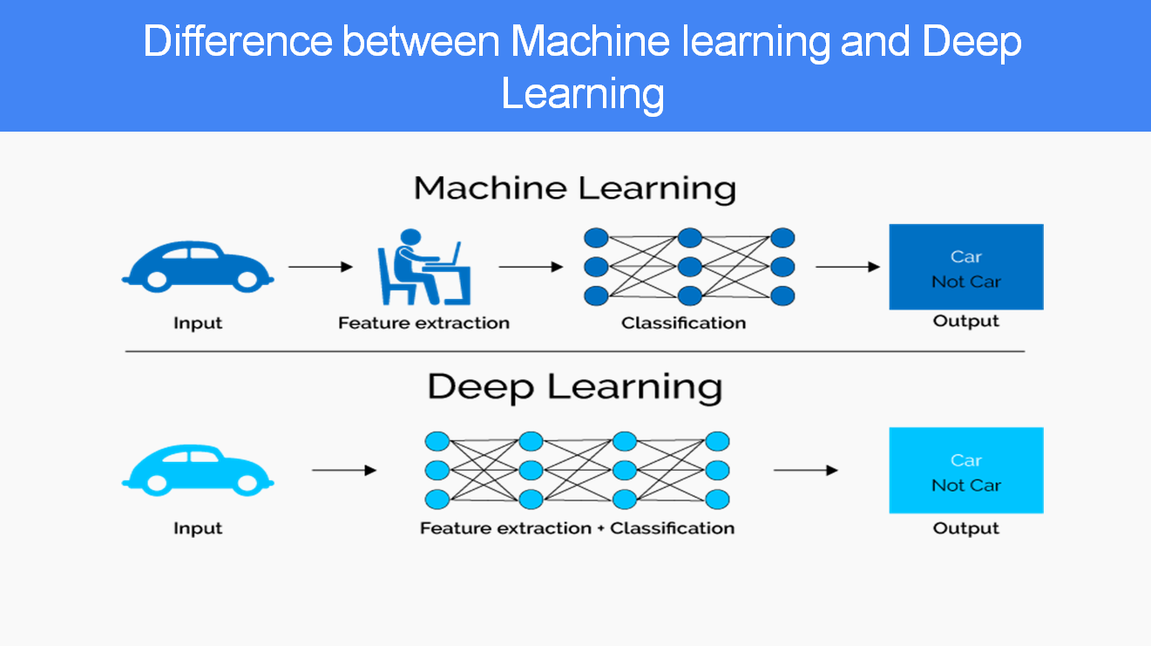
Difference between DL and ML

Slide 21
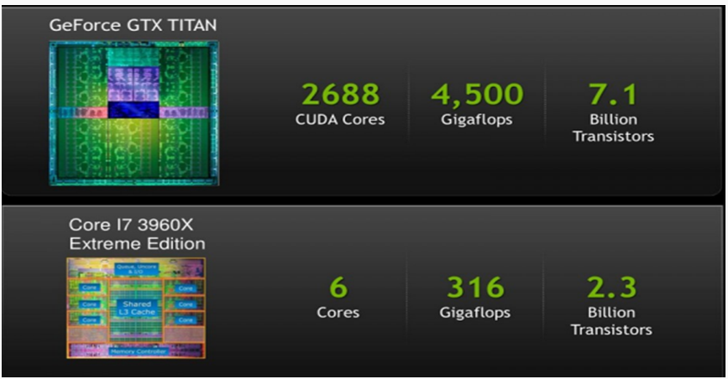
Processing DL with CPU vs GPU
Deep Learning can run on CPUs, but GPUs are far more efficient because they perform many parallel computations at once, significantly speeding up training for large neural networks.

Slide 22
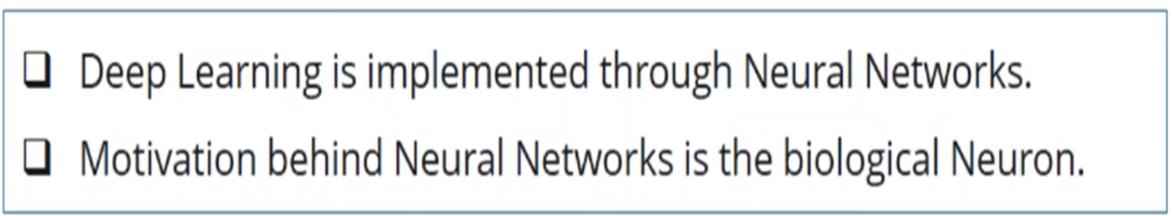
Deep Learning

Slide 23
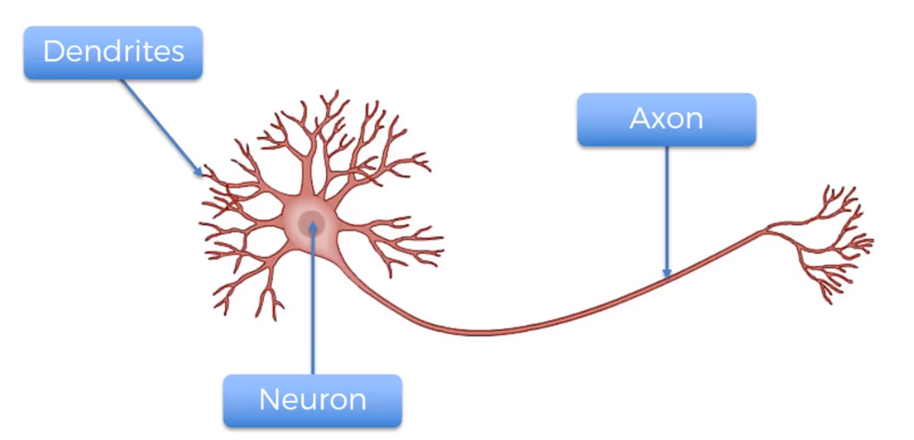
Structure of biological Neuron

Slide 24
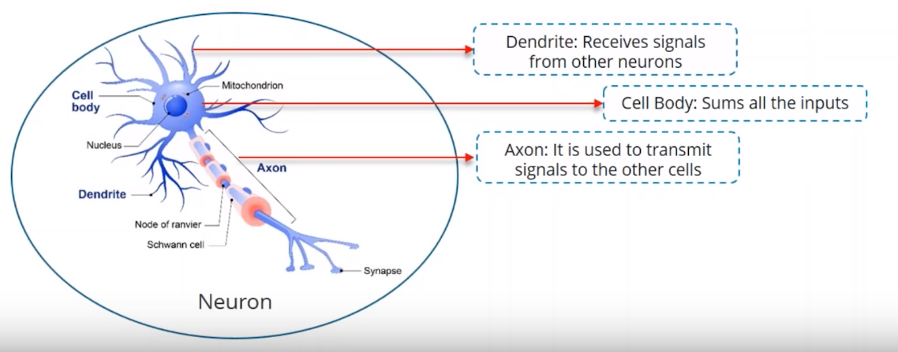
Structure of biological Neuron

Slide 25
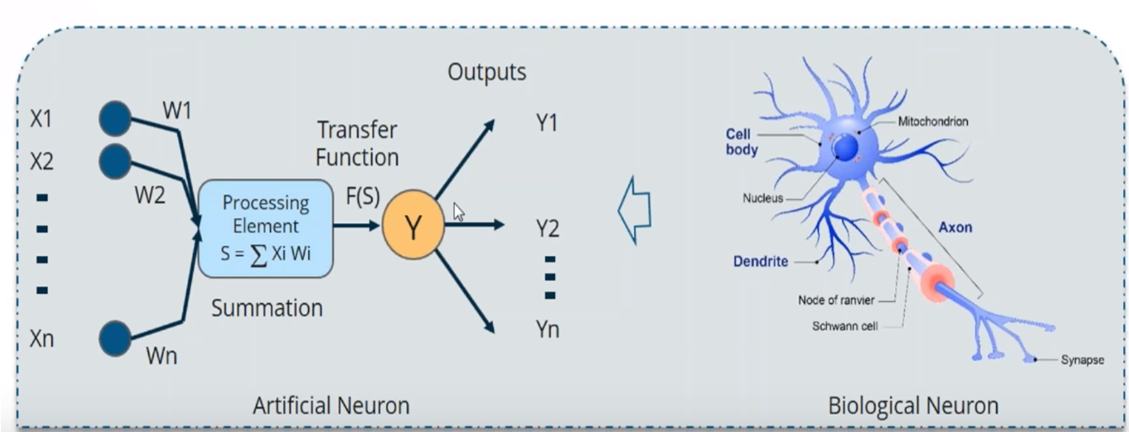
Artificial Neuron in DL

Slide 26
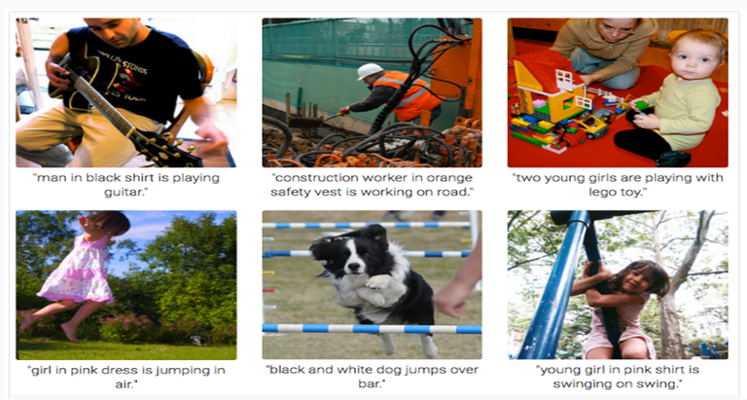
Some use cases of DL
Automatic Image Caption Generation

Slide 27
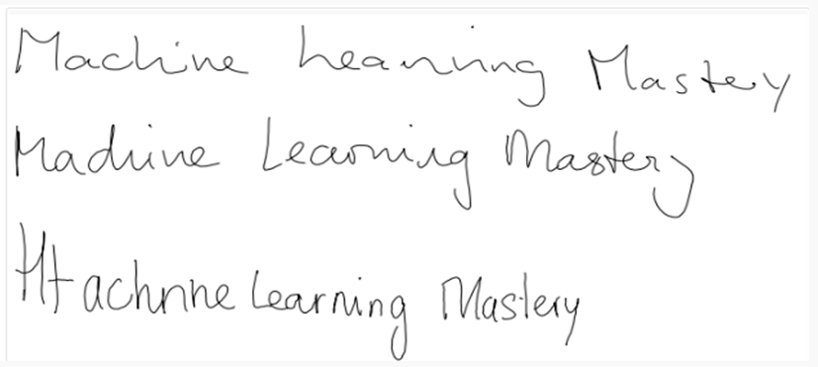
Some use cases of DL
Automatic Handwriting Generation

Slide 28
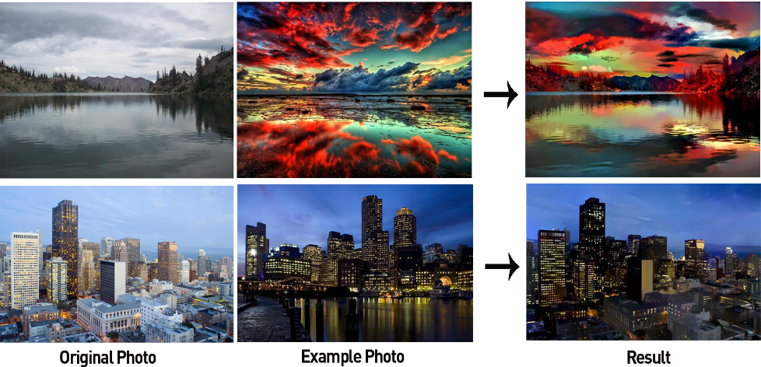
Some use cases of DL
Style Transfer

Slide 29
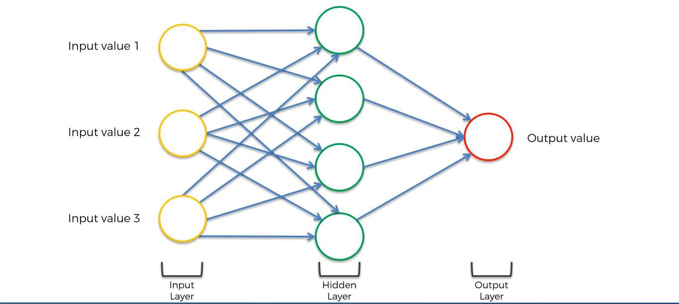
Introduction to Artificial Neural Network (ANN)

Slide 30
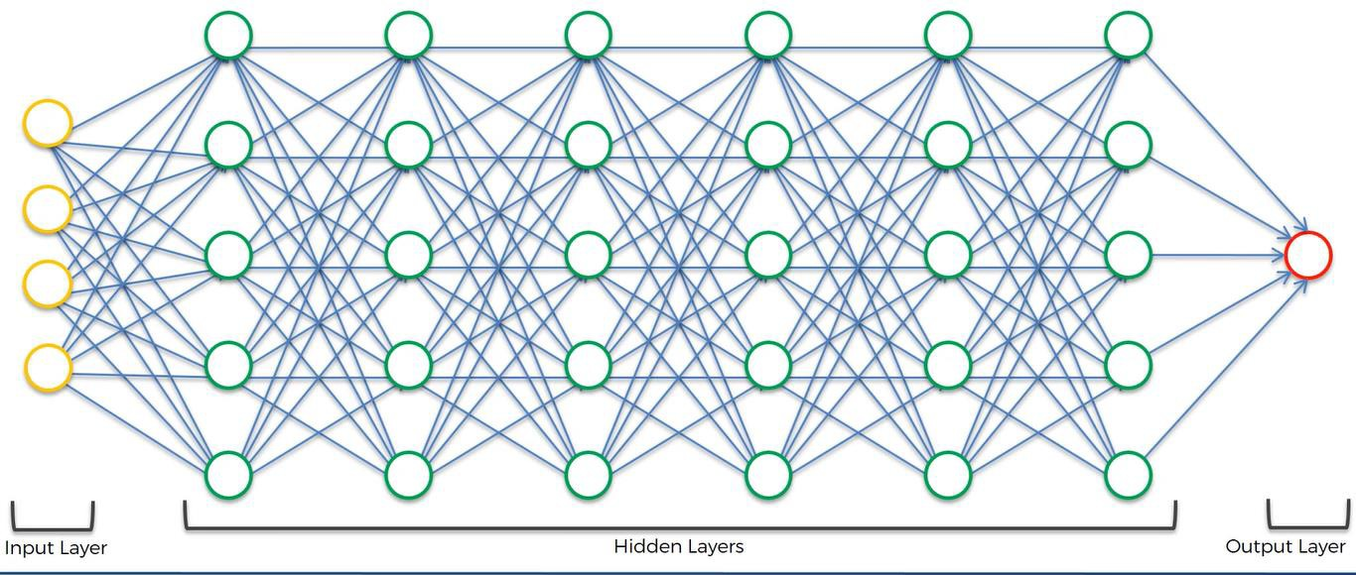
Deep Neural Network in DL
When artificial neural networks (ANN) has multiple hidden layers (hence called "deep"), it forms the basis for Deep Neural Network (DNN).
The field where DNN is used is called Deep Learning.

Slide 31
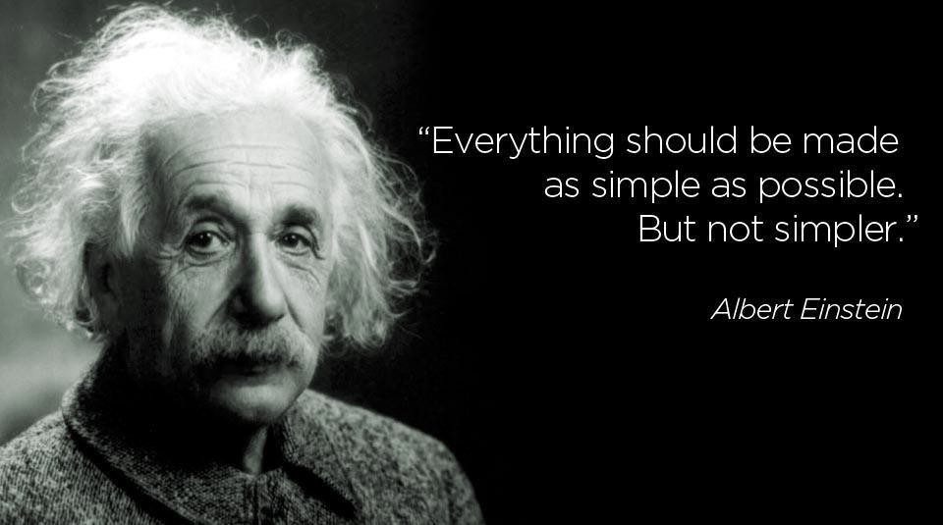
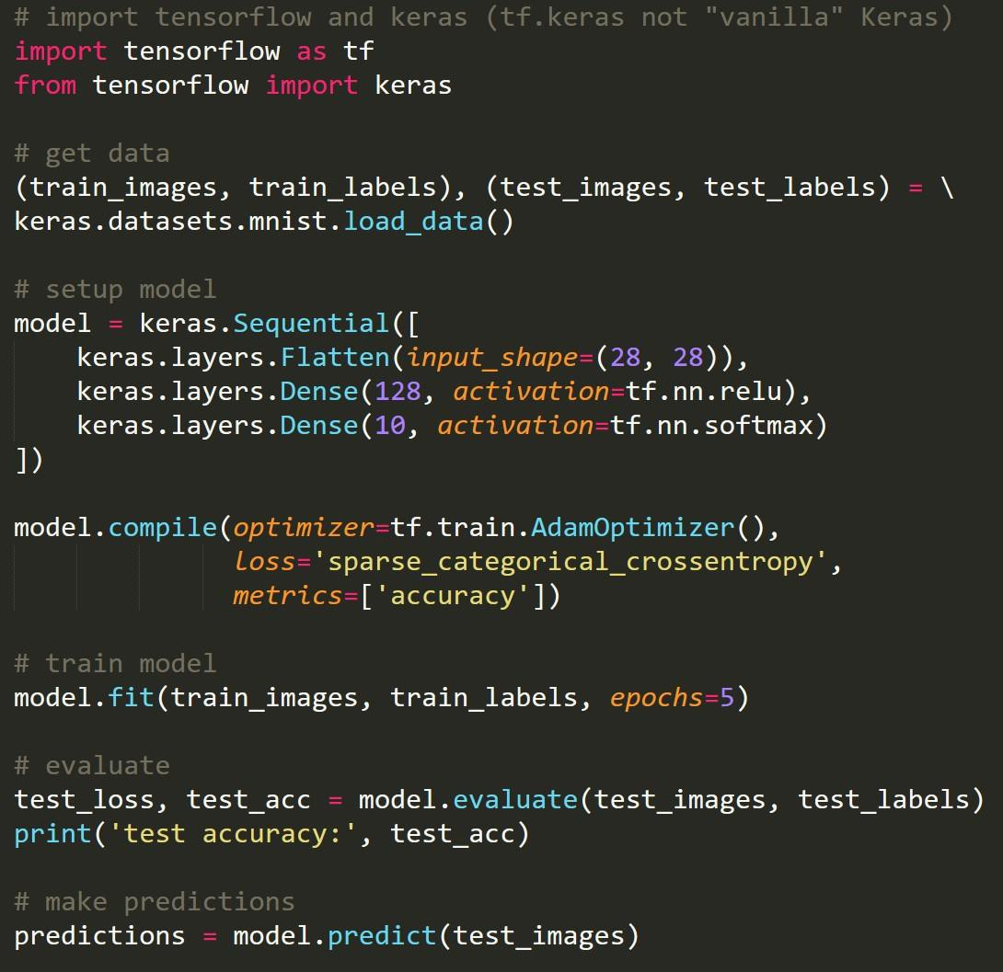

First Steps: Start Simple
1
2
3
4
Input Image:
5
TensorFlow
Model:
Neural
Network
6
5
(with 87% confidence)
7
Output:
6
Access Google Colab Notebook: https://colab.research.google.com/drive/1mB_IFQAd7qbMAhQ2C23a2NEbrNSl_i3R?usp=sharing

Slide 32
In Summary - ML vs DL
Machine learning focuses on developing algorithms that allow computers to learn from data and make predictions or decisions without being explicitly programmed. It includes techniques like supervised learning, unsupervised learning, semi-supervised and reinforcement learning. Machine learning models often rely on structured data and require human intervention for tasks like feature engineering.
Deep learning, on the other hand, is a specialized branch of machine learning that uses artificial neural networks with multiple layers (hence called "deep"). These networks are designed to mimic the structure and functioning of the human brain. Deep learning excels at handling large datasets and complex tasks such as image recognition, natural language processing, and autonomous systems. Unlike traditional machine learning, deep learning models automatically extract features from raw data, reducing the need for manual feature engineering.

